Slide 1


SAP S/4HANA CDS, SAC Training Day 2
Anubhav Oberoy

Slide 2

Agenda – Day 2
Understand data model
Create your first CDS View
Consume CDS view in ABAP Program
Working with CDS entity
--break
Understanding CDS entities examples
Difference SE11 and CDS views
CDS perspective
--break
VDM – Virtual Data Model
Arrangements for VDM objects
Analytic use case
CDS Security and Steps for securing data
Notes:
https://unsplash.com/photos/CPs2X8JYmS8

Slide 3

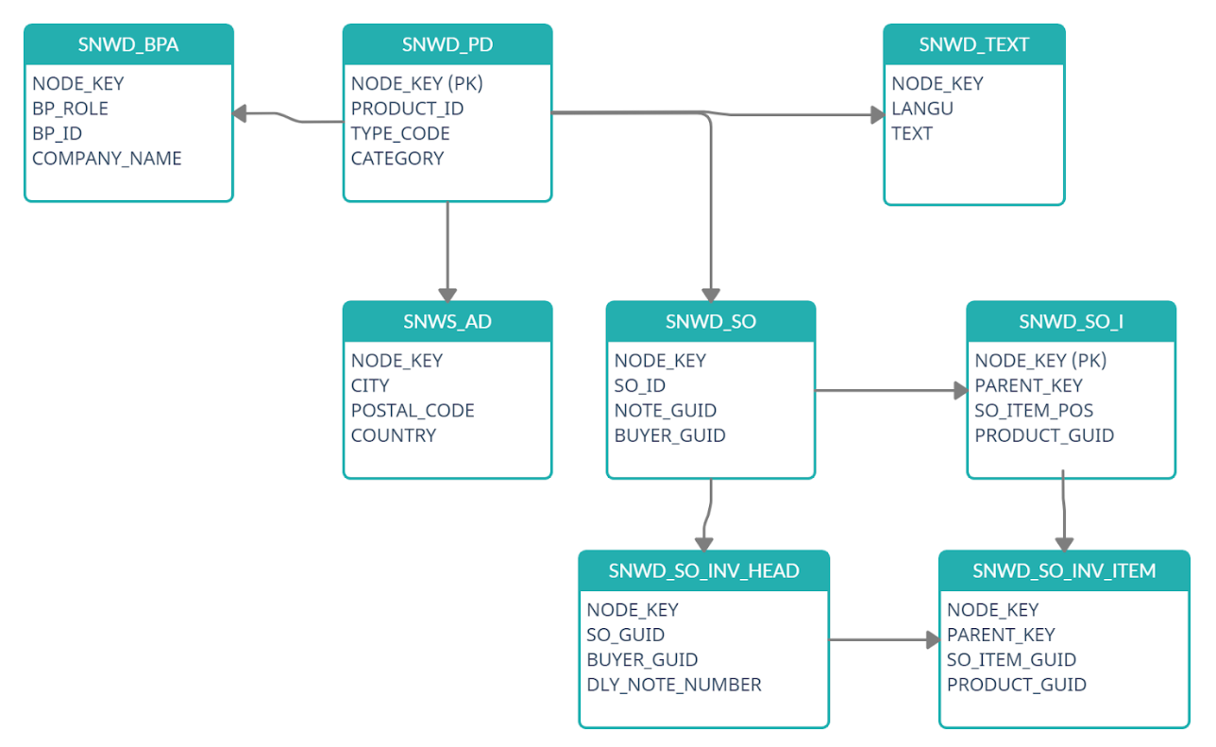
EPM Data Model

Slide 4
What happens when we activate
DDIC view SE11
CDS views
activate
HANA Views
www.anubhavtrainings.com

Slide 5
Create First CDS view
@AbapCatalog.sqlViewName: ‘ZMTXXBASICCDS'
@AbapCatalog.compiler.compareFilter: true
@AbapCatalog.preserveKey: true
@AccessControl.authorizationCheck: #NOT_REQUIRED
@EndUserText.label: 'Simple CDS view'
define view ZMT_XX_BASIC_CDS as select from snwd_bpa
{
key node_key as NodeKey,
bp_role as BpRole,
email_address as EmailAddress,
address_guid as AddressGuid,
bp_id as BpId,
company_name as CompanyName
}

Slide 6
Consume CDS in ABAP program
*&---------------------------------------------------------------------*
*& Report zmt_xx_call_cds
*&---------------------------------------------------------------------*
*&
*&---------------------------------------------------------------------*
REPORT zmt_xx_call_cds.
data ls_bp type snwd_bpa.
SELECT-OPTIONS s_bpid for ls_bp-bp_id.
select * from ZMT_XX_BASIC_CDS into table @data(itab) where BpId in @s_bpid.
cl_demo_output=>display_data(
value = itab
* name =
* exclude =
* include =
).

Slide 7

CDS Entities
CDS Entities are successor of CDS Views. CDS views are deprecated, use CDS entities. CDS views and entities are absolutely same, whatever knowledge you have or gained on CDS views, can be applied on entities.
When we create a entity, system do not create the DDIC view
It saves time hence the activation time of CDS has been improved 90%
With CDS entity there is no name confusion, its just one name for everything.
The generated HANA view name will be same as the name of the main view
CDS entities are stricter in nature
Limitations
For analytical use cases, we still rely on cds views
For bopf integration still we use cds views
For advance concepts like RAP, we can do on entities only.
9
www.anubhavtrainings.com

Slide 8
Working with CDS Examples
Working with CDS entity and CDS with Expression Language (DEL)
View on View Concept
In a real time, environment, we do not want to clutter all our code inside single CDS view. Because we want to achieve modularization. In View-on-View concept, we will consume one view on top of another view. This way we can create multiple reusable views and consume them in upper views.
Adding Aggregation to CDS entities
Joins using CDS entities
Concept of Association
Associations are the relationships between entities and views. It is used to avoid joins, because joins are bad for performance, associations are loose coupling between our data. The data will fetched on-demand when it requested. The join will be performed only when needed, hence saves lots of time.
There are 2 types of association
Ad-hoc association – just exact join
Exposed association – lose coupling

Slide 9
Difference between SE11 Views and CDS views
Parameters | CDS Views | DDIC Views
Code To data paradigm | Yes | No
Complexity | Yes | No
Outer join is supported | Yes | No
Support unions | Yes | No
Complex Expression language | Yes | No
Ability to aggregate data and write where on aggregated | Yes | No
Analytical consumption | Yes | No
Support for OData Service | Yes | No
Allowing Type definition | Yes | No
Metadata extension for UI Consumption | Yes | No
Parameters and predicate support ($session) | Yes | No
S/4HANA Embedded Analytics Support | Yes | No

Slide 10
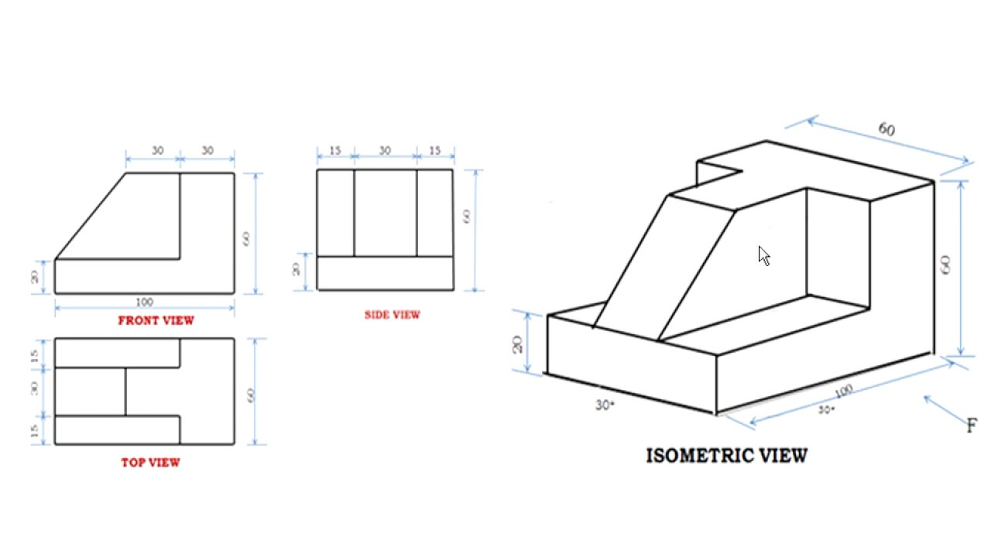
Why someone fails to learn CDS from google?
< >
9
www.anubhavtrainings.com

Slide 11

CDS Perspective
ABAP Program
@Odata.publish
Fiori App
@Analytics
@AnalyticDetails
CDS View
Data Analytics
@Odata.publish
S/4HANA embedded Analytics
@Analytics
@AnalyticDetails
Integration API
@Odata.publish
@ObjectModel
RAP/BOPF
9
www.anubhavtrainings.com

Slide 12
VDM – Virtual data modeling
Is a gold standard and best practice to build CDS views in S/4HANA projects. This standard is adopted already by SAP so by learning this you will also be able to understand standard CDS view structures.
When we join a project, we would not need any KT from anyone if project follow VDM
In absence of a colleague, we will be able to manage the development and understand purpose
When SAP deliver standard CDS views, they do not share mobile no. of their SAP labs developer
It allows great modularization and the best practices for a scalable project design
Interface views
Private
Consumption
Starts with P_
@VDM.private: true
These are the views built by SAP and reused by SAP itself.
As a developer we can use private views to build our views but we must not?
SAP do not guarantee the stable contract
Basic
Composite
Starts with C_, @VDM.viewType : #COMPOSITION
They are used for final consumption for our use case e.g. Fiori App, Analytics, Integration etc.
Annotations related to final UI and tool consumption
In Data analytics we create with annotation @Analytic.query: true
Which creates a BeX query in SAP S/4HANA.
Starts with I_, @VDM.viewType : #BASIC, #COMPOSITE
We can certainly use them in our projects, view on view because contract remains stable RoR
Basic views are always used to ready either Pure Master or Pure transaction
If we want combination of master and transaction data we can go with composite views
A composite view can act like a #CUBE view for data analytics. Usually these views are used to aggregate data with @DefaultAggregation annotation
We can build interface views on top of private(our) or other interface views
9
www.anubhavtrainings.com

Slide 13
Arrangement
Fiori App
Analytic Tools
Third Party
API Consumer
Consumption views
Consumption views
@Analytic.query
Interface composite views
Interface Composite views
#CUBE
Basic interface views
Basic interface views
Basic interface views
Private views
Private views
DB Tables
DB Tables
DB Tables
DB Tables
DB Tables
DB Tables
DB Tables
9
www.anubhavtrainings.com

Slide 14
Use Case
We are working as S/4HANA consultant in a company, the company have sales stored in the EPM data table. We would like to build a dashboard to help company projecting following requirement
Total sales per Country – total gross amount, max net amount, average tax amount
Total Sales per Currency
Total Sales per Product
Total Sales per Customer
9
www.anubhavtrainings.com

Slide 15
Use Case
We have business partner data of multiple counties displayed on the BUPA view. We want to secure this data, we want also row level security. That a manager who is working in US can only see USA customers hence a manager in Japan must only see the Japanese customers.
User
CDS DCL
Auth Class
1..*
Role
Auth Objects
Profile
1..*
Auth Fields
value
9
www.anubhavtrainings.com

Slide 16
Steps
Transaction code SU20 and define an authority field since we want to control permissions based on Country we will use the field as Country. - ZCTRY_APR
Go to transaction SU21 and create a authority class (ZBUP) and authorization object (ZAPR_BUPA).
We add the authority field to the object and a new filed ACTVT with type as 03
Open tcode pfcg and create a new role - ZAPR_BR_CDS_BUPA
9
www.anubhavtrainings.com

Slide 17
Title
Text

Slide 18
Title
Text

Slide 19

Questions?

Slide 20

Thank you
Anubhav.abap@gmail.com
contact@anubhavtrainings.com
+91 84484 54549
www.anubhavtrainings.com

